Slide 1
Internal Training
MVC in Portlet
Tp.HCM - Apr/2011

Slide 2
MVC in Portlet
Le Ngoc Thach
Tp.HCM - Apr/2011

Slide 3
Objectives
Can explain the main differences between JSP Model Architecture 1 & 2
Understand a popular MVC framework - Struts
Can explain What & Why Portlet
Can implement/run an out-self MVC framework for Portlet

Slide 4
Contents
JSP Model Architecture 1 & 2
Overview Struts framework
What, Why Portlet
MVC in Portlet

Slide 5
JSP Model Architecture 1
1
2
3

Slide 6
JSP Model architecture 2
2
1
3
4
5

Slide 7
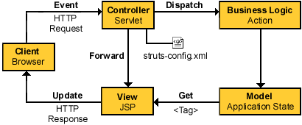
How Struts work

Slide 8
What is a Portlet?
Java technology based web component
Managed by a portal container
Generates a piece of markup called “fragment”
  Adheres to certain rules such as no <html> tags, for instance
  Fragment generated by a Portlet aggregates with that from other Portlets to form a portal page
  Fragment generated by a Portlet may vary from one user to another depending on the user configuration

Slide 9
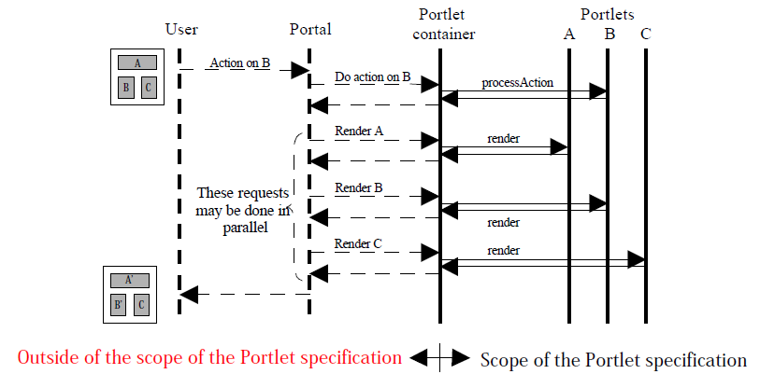
Portal and Portlet Interaction

Slide 10
Why Portlet?
(Why can't we use Servlet?)

Slide 11
Why Portlets?
Servlet architecture does not define the Desktop metaphor where markup aggregation can occur
Servlet architecture does not define the possible states and transitions of an included Servlet or JSP
Servlet architecture does not define how the state of one Servlet or JSP affects the display of the other included Servlets or JSPs

Slide 12
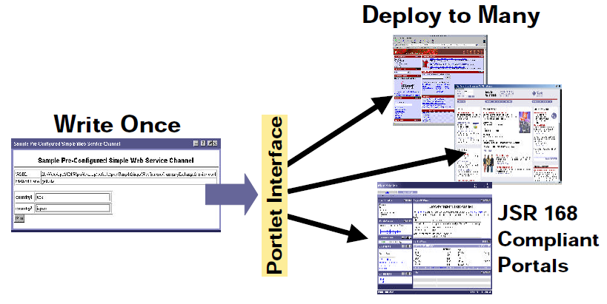
Why Portlets [cont]?

Slide 13
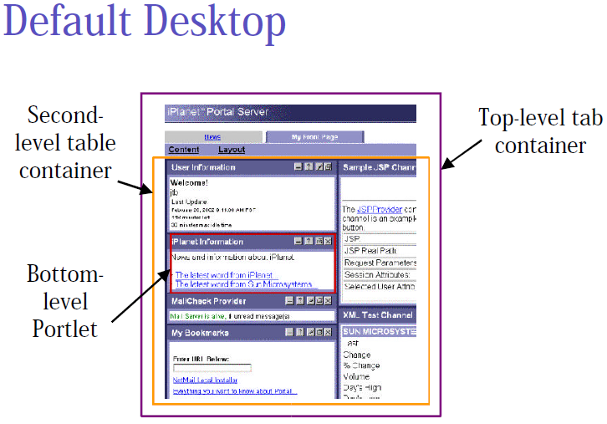
MVCPortlet - concepts
Natural programming style
  Screen Central
  Event-based processing
Screen
Event

Slide 14
MVCPortlet components
Core controller: MVCPortlet
XML Configuration
Bean Utilities
<?xml version="1.0" encoding="UTF-8"?>
<corewa>
<view-screen>Menu</view-screen>
<edit-screen>Edit</edit-screen>
<help-screen>Help</help-screen>
<screen id="Menu" control="rocky.corewademo.control.MenuControl"
input="/WEB-INF/jsp/menu.jsp">
<event id="list" redirect="yes" nextScreen="/WEB-INF/jsp/list.jsp"></event>
<event id="add" procId="procAdd" nextScreen="/WEB-INF/jsp/add.jsp"></event>
</screen>
<screen id="List" control="rocky.corewademo.control.ListControl">
<event id="search" procId="procSearch"
nextScreen="/WEB-INF/jsp/list.jsp">></event>
<event id="goHome" redirect=”yes”
nextScreen="/WEB-INF/jsp/menu.jsp"></event>
<event id="next" procId="procNext"></event>
<event id="prev" procId="procPrev"></event>
</screen>
</corewa>

Slide 15
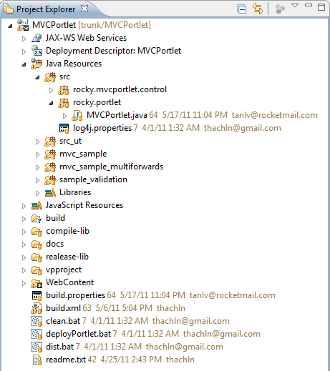
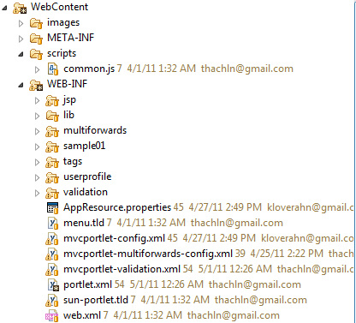
MVCPortlet Source Code
Source code in GoogleCode
https://mvcportlet.googlecode.com/svn/trunk/MVCPortlet

Slide 16
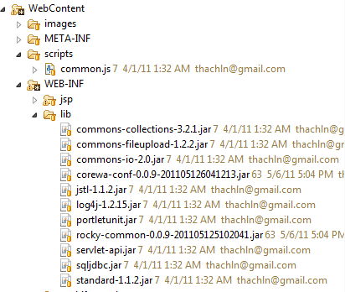
MVCPortlet Source Code
https://open-ones.googlecode.com/svn/trunk/CoreWa-Config
https://open-ones.googlecode.com/svn/trunk/RockyCommon

Slide 17
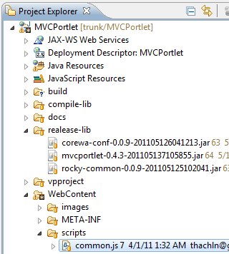
MVC Binary package

Slide 18
MVCPortlet project built-in samples
Sample for test MVCPortlet

Slide 19
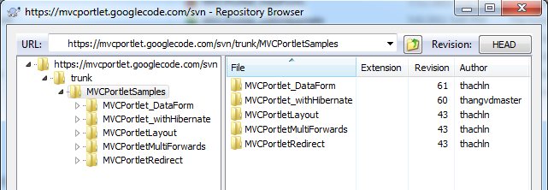
External MVCPortlet-based samples
https://mvcportlet.googlecode.com/svn/trunk/MVCPortletSamples

Slide 20
References
Portlet Specification
http://web.princeton.edu/sites/isapps/jasig/
2003winterMiami/presentations/SangShinportlet.pdf
http://groups.google.com/group/mvcportlet
http://mvcportlet.googlecode.com/
http://open-ones.googlecode.com/

